Slide 1
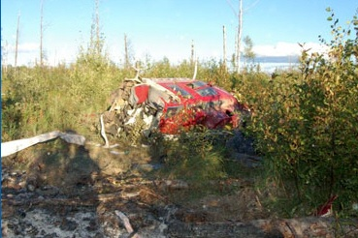
WIRE STRIKE ACCIDENTS
Notes:
A good opening slide

Slide 2
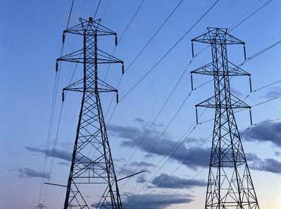
Where is the Wire Environment?
Except for mountainous areas, the wire environment is any airspace below 500 feet AGL. In mountainous areas it is any airspace below 500 feet above the highest ridgeline.
Notes:
Where

Slide 3
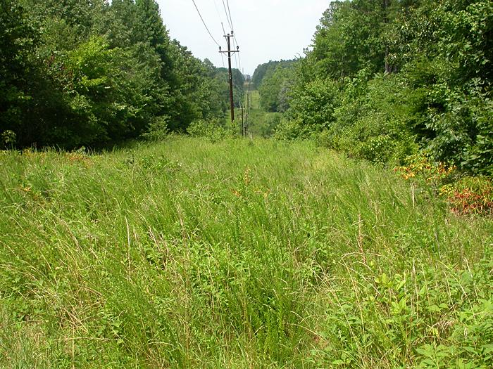
What constitutes a wire hazard?
A wire hazard is any wire or structure that presents a danger to aircraft. Any aerial wires or structures that supports those wires are all considered wire hazards.
Notes:
What is a wire hazard. Power lines, poles, towers, guy wires, etc.

Slide 4
Here are a few statistics. 2009
 177,446 airplanes flew an average of 107 hrs/yr
 8% low level
 9,984 helicopters flew an average of 300 hrs/yr
 29% low level
 Helicopters
 42% low level / fatality rate 37%
 Not low level / fatality rate 53%
Notes:
Helicopters 5.3% GA fleet, fly 13.6% of hours, do 36.8% low level. Why the difference in fatalities? Helmets, shoulder harnesses, nomex, SPEED

Slide 5
Occurrence Category | # of Accidents | % of CY2006
LOC – Loss of Control | 59 | 38.8%
2. AUTO - Autorotation | 55 | 36.2%
3. SCF - System Component Failure | 43 | 28.3%
4. STRIKE | 28 | 18.4%
11. CFIT | 6 | 3.9%
Notes:
The major FAA hot button, CFIT is only number 11 in the accident parade. Loss of control is like LTE, Settling w/power, Dynamic rollover, etc

Slide 6
Phase of Flight | Number | Percentage
Take Off | 1 | 3.0%
Hover | 5 | 15.2%
En Route | 7 | 21.2%
Maneuvering | 13 | 39.4%
Approach | 2 | 6.1%
Landing | 5 | 15.2%
Strike Category Phase of Flight CY2001

Slide 7
Standard Problem Statement | Frequency Used
Pilot’s flight profile unsafe for conditions | 11
Aircraft position and hazards | 9
Low flight near wires | 7
Flying near hazards, obstacles, wires | 7
Disregard of known safety risk | 5
Perceptual judgment errors | 5
Selection of inappropriate landing site | 5

Slide 8
LEVEL 1 SPS STRIKE CATEGORY | 225
Pilot Judgment & Actions | 53
Pilot Situation Awareness | 34
Mission Risk | 22
SPS = Standard Problem Statement

Slide 9
LEVEL 1 INTERVENTIONS STRIKE CATEGORY | 220
Safety Management | 55
Training/Instructional | 52
Data/Information | 45

Slide 10
Occurrence Code | Description | Accident Count
HTOL | Strike during a takeoff or landing | 9 (32.1%)
OBJ - H | Object strike of helicopter | 16 (57.2%)
 | Total: All Strike Accidents | 28 (100%)
STRIKE Occurrence Analysis CY2006
Notes:
This slide shows when 70% of strikes occur. Just state that percent and that it is other than t/o & landing!

Slide 11
Objects | CY2000 | CY2001 | CY2006
Wire | 10 (45.5%) | 9 (47.4%) | 11 (45.8%)
Tree | 9 (40.9%) | 5 (26.3%) | 8 (33.3%)
Pole |  | 2 (10.5%)
Total | 22 (100%) | 19 (100%) | 24 (100%)
Object Struck Initiating Accident

Slide 12
Height AGL (feet) | CY2001 | CY2006
≥ 50 Ft | 4 (44%) | 7 (63.6%)
51 to 100 ft | 0 | 3 (27.3%)
101 to 150 ft | 3 (33.3%) | 1 (9.1%)
Total | 9 (100%) | 11 (100%)
Wire Strike Height
Notes:
Majority of accidents occur at or below 50 feet AGL

Slide 13
Operating Regulation | CY2001 | CY2006
Part 91 | 16 (48.5%) | 21 (75.0%)
Low level operators (Parts 133/137 &Public Use) | 15 (45.5%) | 5 (17.9%)
Total | 33 (100%) | 28 (100%)
Operating Regulation during Accident Flight
Notes:
Part 91 over 50% increase between 2001 and 2006. Vast majority of accidents were Part 91.

Slide 14
Based on the accident reports:
 Average wire accident pilot had:
 7225 hrs TT
 5230 hrs Rotorcraft
 1816 hrs Make & Model
 Almost half KNEW the wires were
there
Notes:
All it takes is a moment.

Slide 15
Notes:
AC70/7460-1K Available on line at FAA.gov

Slide 16
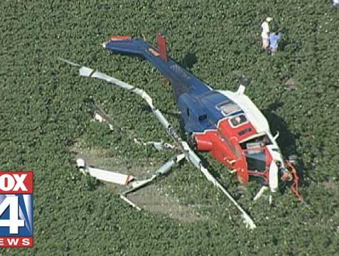
Notes:
OK

Slide 17
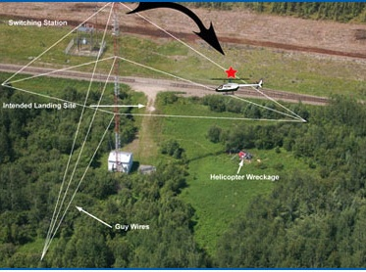

Slide 18
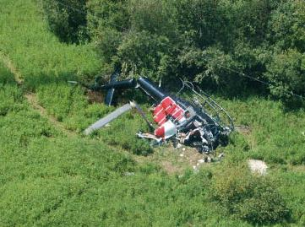

Slide 19
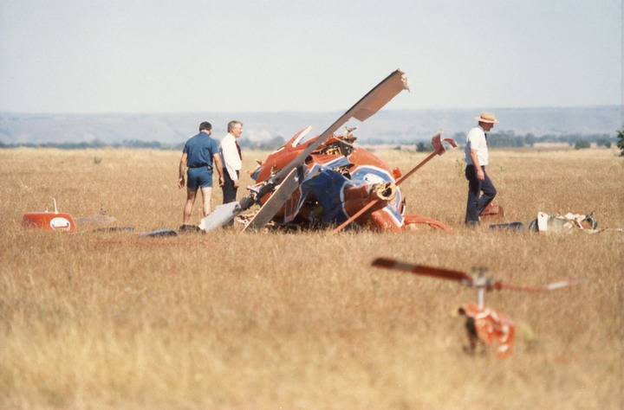

Slide 20
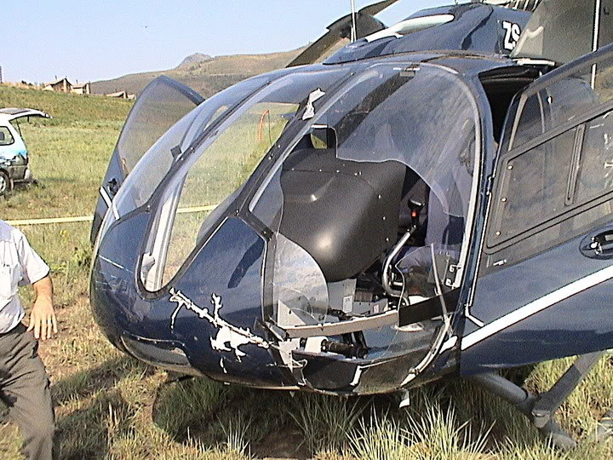

Slide 21
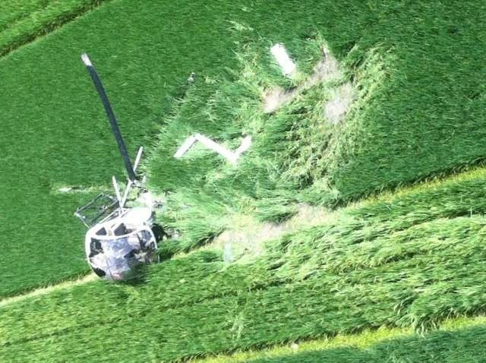

Slide 22
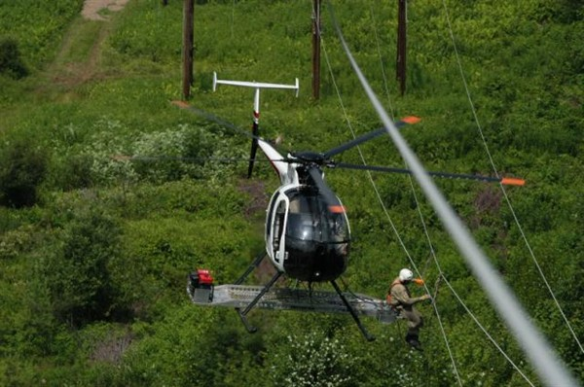
Considering what appears to be a very elevated risk factor, what may be surprising, is that during a 10 year period, only 2 accidents involved an aircraft conducting power line work. They were both airplanes conducting power line patrols.
Why such a difference?
There are some good reasons for this

Slide 23
Notes:
Training, Training and more training.

Slide 24
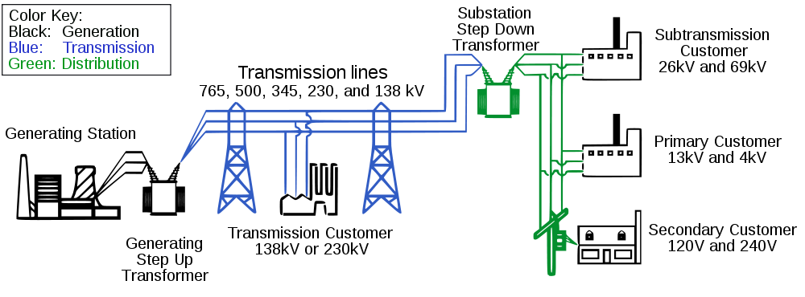

Slide 26
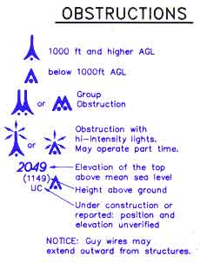
Notes:
<200 feet not required to be marked, lit or painted.

Slide 27
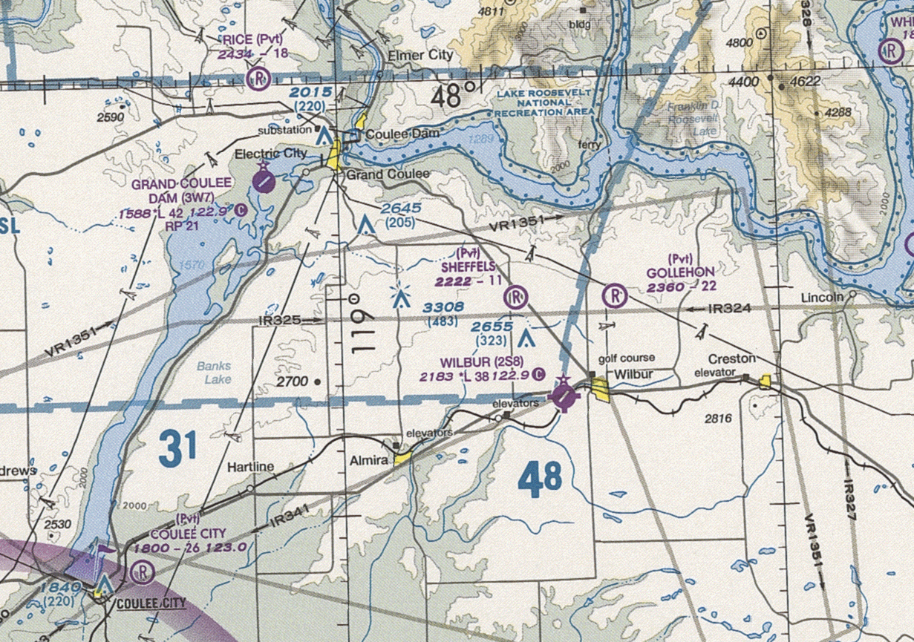
Grand Coulee Dam
Notes:
9 sets of lines

Slide 28
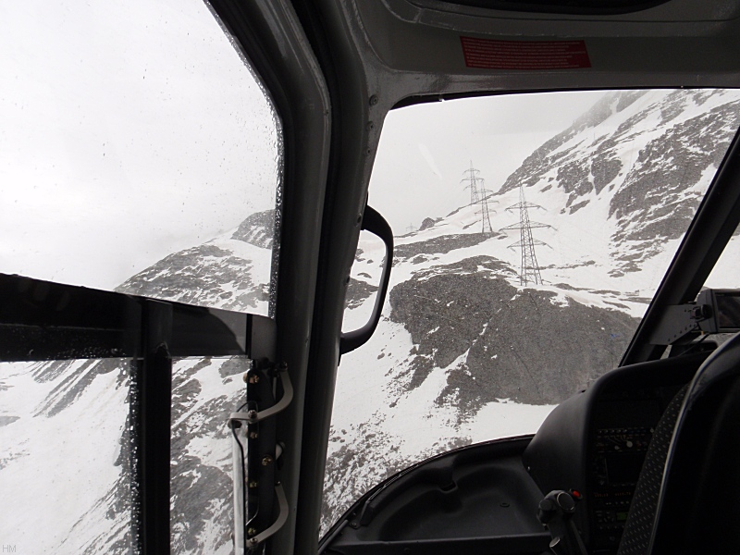
‘I’ll be able to see the wires in time.’
Depending on the lighting conditions and background, wires and even poles and towers
can and do disappear.
‘I’ll plot it on my charts.’
Not all power lines are depicted on aeronautical charts.
Notes:
Most high tension wires are un-shielded. They are usually made of aluminum with a steel core or of aluminum alloy. So they corrode and change color. At the normal flight speeds, the wires all but disappear until it is too late. Depending on lighting conditions and background wires and structures can and do disappear. Try to find the wires in this picture.

Slide 29
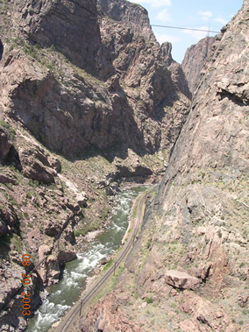
Some of the elevated wire danger zones, include valleys
Notes:
Not only can there be wire right of ways along the floor of the valley, but also right of ways across the valley and wires from ridge top to ridge top. And just because you fly over the tower, it doesn’t mean you are above the wires.

Slide 30
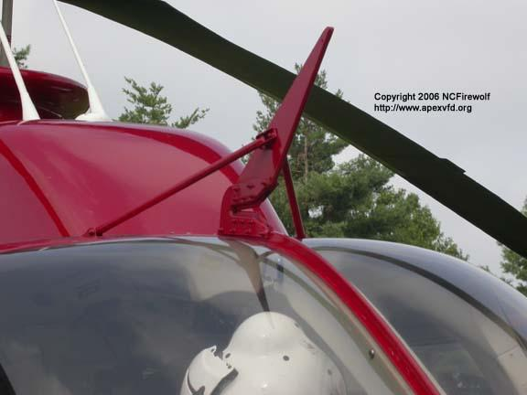
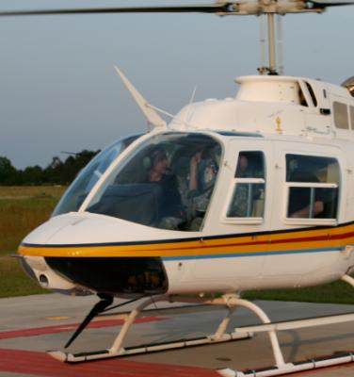
My helicopter has wire cutters!
If you had a properly installed and maintained set, were heavy enough, were going fast enough and hit the wires at the right angle, you should cut wires of 3/8 to ½ inch in diameter.
Installed wire cutters are more of a last chance safety device. I wouldn’t bet my life on them.
Of the 11 accidents involving a wire strike in CY2006, three had the WSPS kit installed.

Slide 31
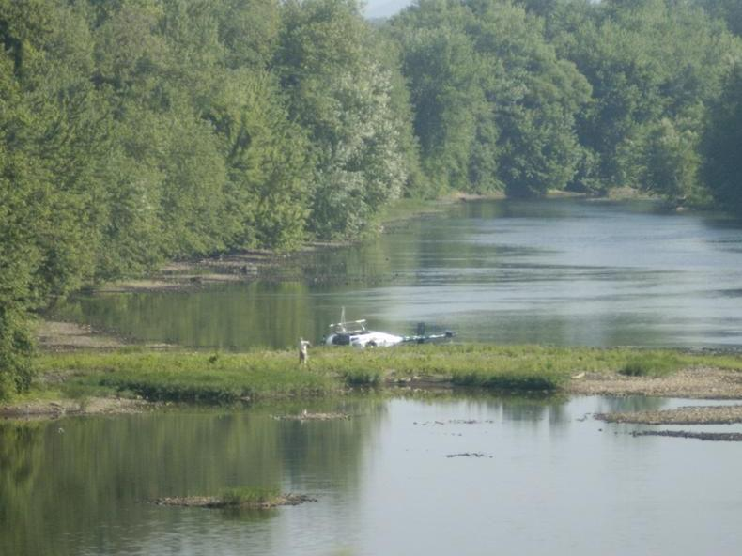
Bodies of water are another high risk area. Not just rivers, but also some lakes have wires strung across them.
Notes:
AOPA Pilot magazine had an article about flying across the North Atlantic in small aircraft. Narrsaarag there is a power cable across the Foard.

Slide 32
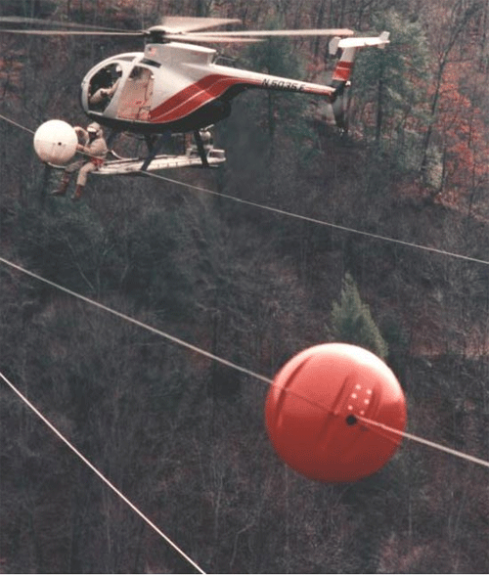
‘Well, I’ll look for the orange balls’
The problem is that most wire crossings are not marked by the orange balls. And the few that are marked, just mark the lateral location of the wires, not the top or bottom wires.
Almost half of the wires hit were marked!
Notes:
Power companies policies vary from company to company. Generally they mark wires where is a presived high risk of wire strikes. Plus they only mark the lateral location of the wires not the vertical.

Slide 33
What can pilots do to limit their exposure to wire strikes?
 STAY OUT OF THE WIRE ENVIRONMENT
 Do a good recon
 High Recon
 Low Recon
 Ground Recon
 CRM
 Anything man-made
 No straight lines in nature
 Stay alert
Notes:
I can’t put it any better than the line by the GySgt in ‘Fire Base Gloria’ “Stay Alert! Stay Alive! It’s as simple as that, people.”

Slide 34
CONCLUSIONS CY2006 USJHSAT Report
The strike category accidents were a significant portion (18.4%) of all CY2006 helicopter accidents.
Primary Issues:
1. Poor Aeronautical Decision Making
2. Poor Risk Assessment
Recommended Interventions:
1. More aeronautical decision-making training,
2. Better company SOPs, standardization, and training.

Slide 35
RECOMMENDATIONS CY2006 USJHSAT Report
An SMS program that includes significant
strike-related recognition and avoidance
training.
2. Mission-specific training.
Operational control implementation and
enhancement (including company
monitoring and enforcement).
4. Risk management training – low altitude
operations.
5. Maintain the minimum safe altitude for the
operation.

Slide 36
Met Towers
(Meteorological towers)
Possible hazard to low altitude flight operations

Slide 37
Met Towers
MET towers
(Meteorological towers)
Are used to gather wind data necessary for site evaluation
and development of wind energy projects.
They can be erected very rapidly and may be on site from a
few days to up to a year or longer. Four men less than 4
hours, up or down.

Slide 38
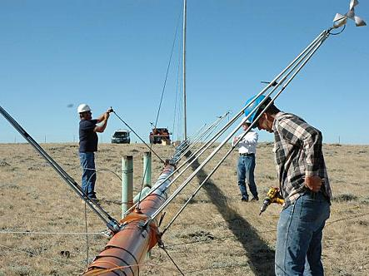

Slide 39
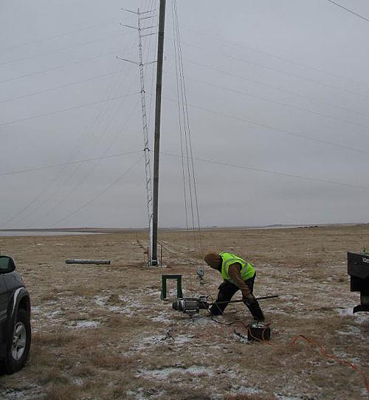

Slide 40
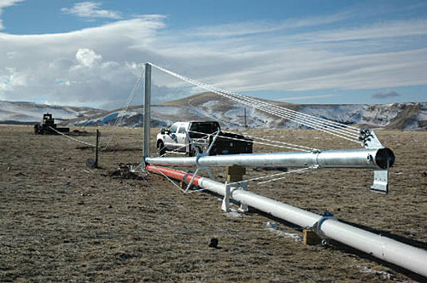

Slide 41
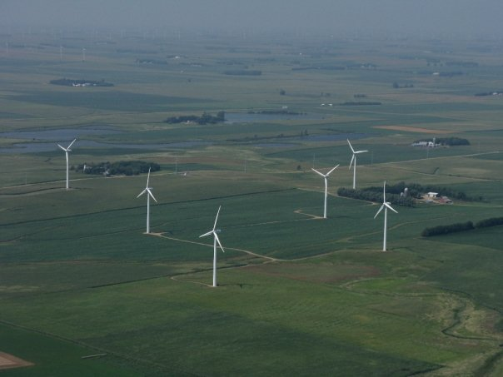

Slide 42
Met Towers
Towers generally range in height from 30, 50, 60
and 80 meter tall.
Any tower less than 200 feet in height is not
required by regulation to be marked or lighted.
At this time there is no standardized notification
system in place to indicate when and where these
towers are erected.

Slide 43
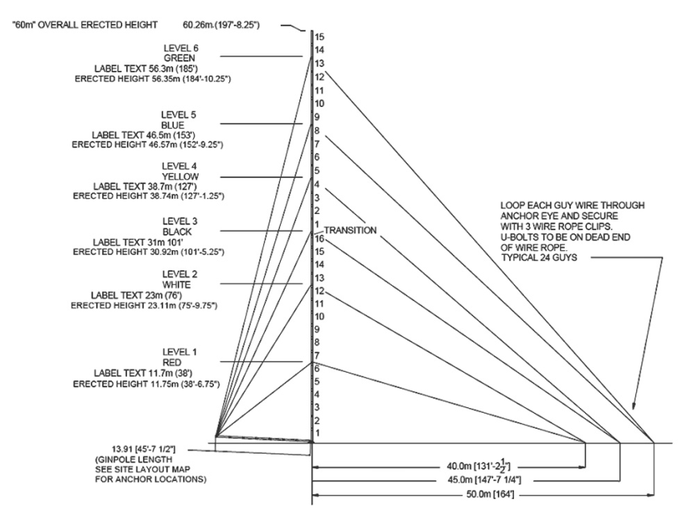
Standard footprint of a tower

Slide 44
Met Tower Photos
The following photos were taken :
At designated
Between: 12:15 and 12:30 PM local time
At a distance of 1/8 of a mile (660 feet)

Slide 45
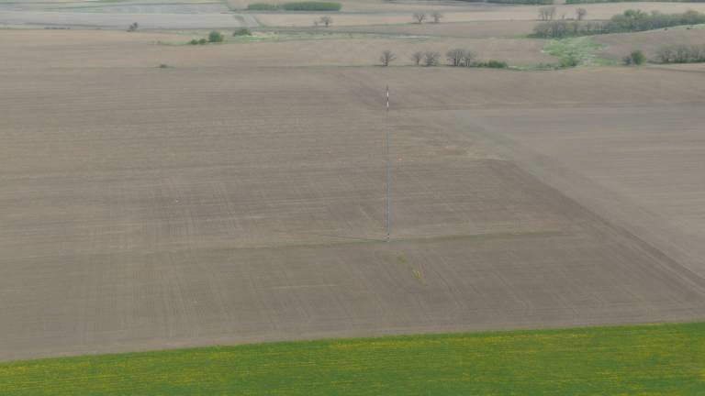
Sachs Tower
500’ North View
Notes:
State/show how difficult towers are to see. One slide is enough as you will be running out of time long before this.

Slide 46
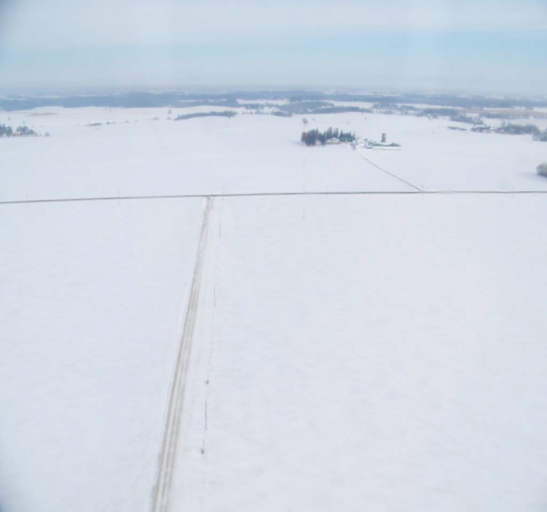
Greenslade Tower 500’ North View
Notes:
Great slide in winter conditions.

Slide 47
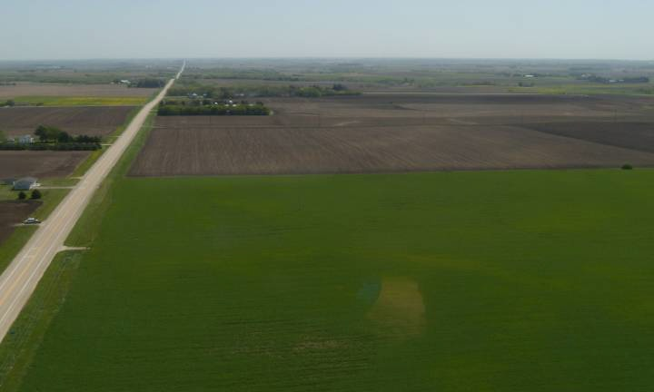
Heins Tower 300’
East View

Slide 48
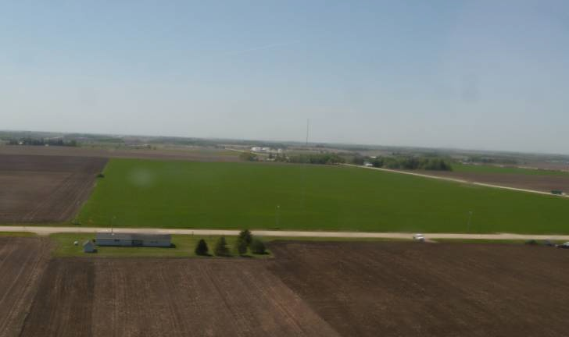
Heins Tower 100’
South View

Slide 49
Resources
http://www.rotor.com/Publications/HAIVideosLibrary/SurvivingtheWiresEnvironment.aspx
Utilities/Aviation Specialist's Inc
www.helicoptersafety.com
International Helicopter Safety Team
www.ihst.org
FAAST
http://www.faasafety.gov/
Notes:
Any Questions. Thank you. Part of handout only

Slide 50
RECOMMEND READING
http://www.faasafety.gov/gslac/ALC/lib_tableofcontents.aspx
faasafety.gov/files/notices/2010/May/Met_tower_Power_Point_St._Cloud.pdf
faasafety.gov/files/notices/2010/May/towerarticle2008.pdf
Flying in Flat Light and White Out Conditions
faasafety.gov/files/notices/2010/May/IA_APB_09-04_Hazard_Maps.pdf
Notes:
Part of handout only

Slide 51
Notes:
Optional if time. Support of your ADM talk

